Slide 1

Deeper Dive MVC 5
Looking under the hood

Slide 2

WHO AM I
Developer Principal at U of A
Over 22 years in software
Started with ASP in 1997
Scholarship Universe
CodeWryte@twitter
dmerson@github
Working on book Virtue of Being Wrong

Slide 3
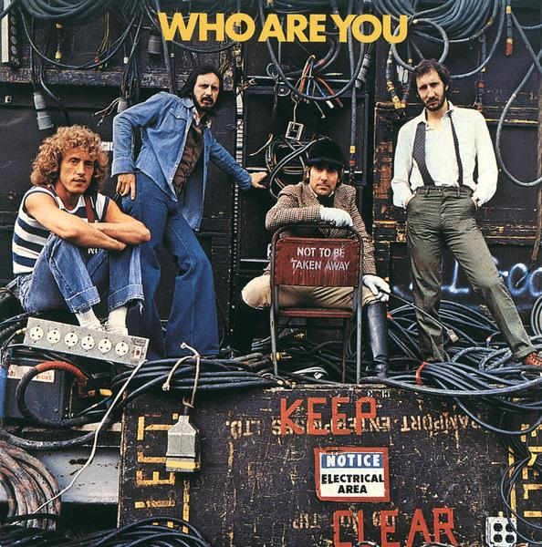
Who are you
Your name
What you do
MVC Experience
Something fun about you

Slide 4
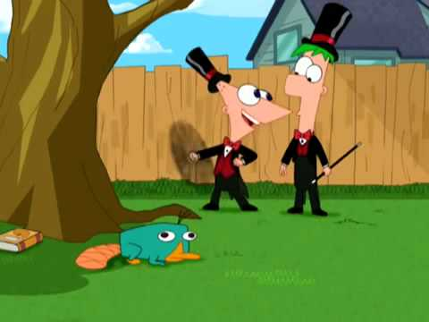
What I am going to do
Use latest researching for long term learning

Slide 5

Quizes
Learning tool
Not dipstick for how much learned
Memory is write operation
Priming

Slide 6

Talk about topic

Slide 7

Have you write down as much as you remember
Take a break
Rinse and Repeat

Slide 8

Theme
We who cut mere stones must always be envisioning cathedrals.

Slide 9
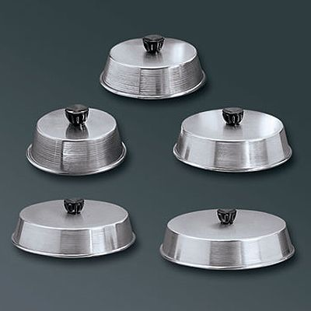
What we are going to cover
MVC Design Patterns
Basic MVC Insides
Routing
LINQ
Entity Framework
JavaScript and jQuery

Slide 10

Initial Thoughts
MVC requires you to know 3 languages
C# or VB.NET
JavaScript
SQL
I want to talk about testing but…
We probably won’t time
But I might move things around

Slide 11
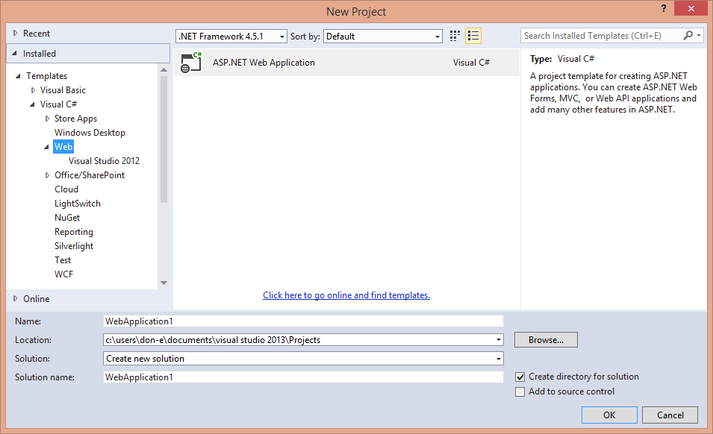
Everyone let’s make a new MVC application

Slide 12
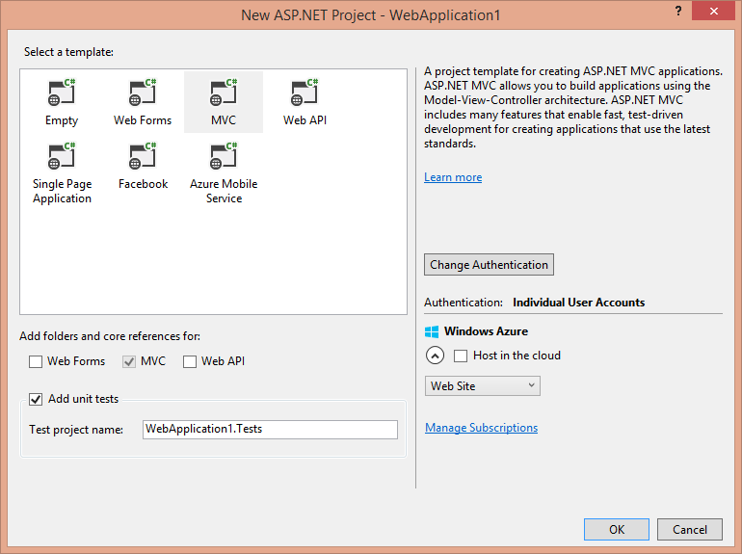

Slide 13
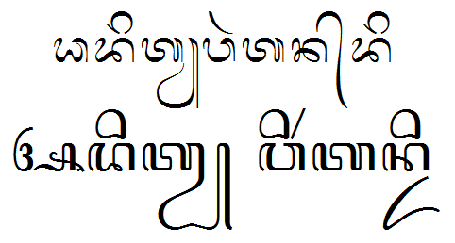
Scripting Language
Compile right before running
If doesn’t compile, stops execution

Slide 14
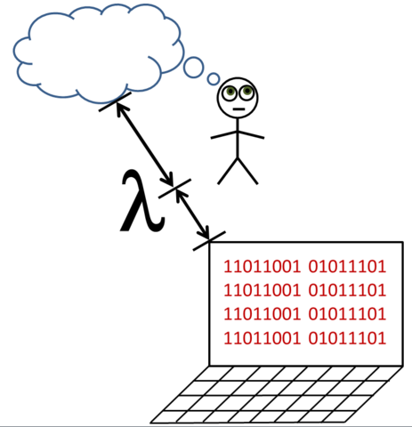
Compiled Language
Code compiled into another form
This other form is run
Can’t run unless it compiles

Slide 15
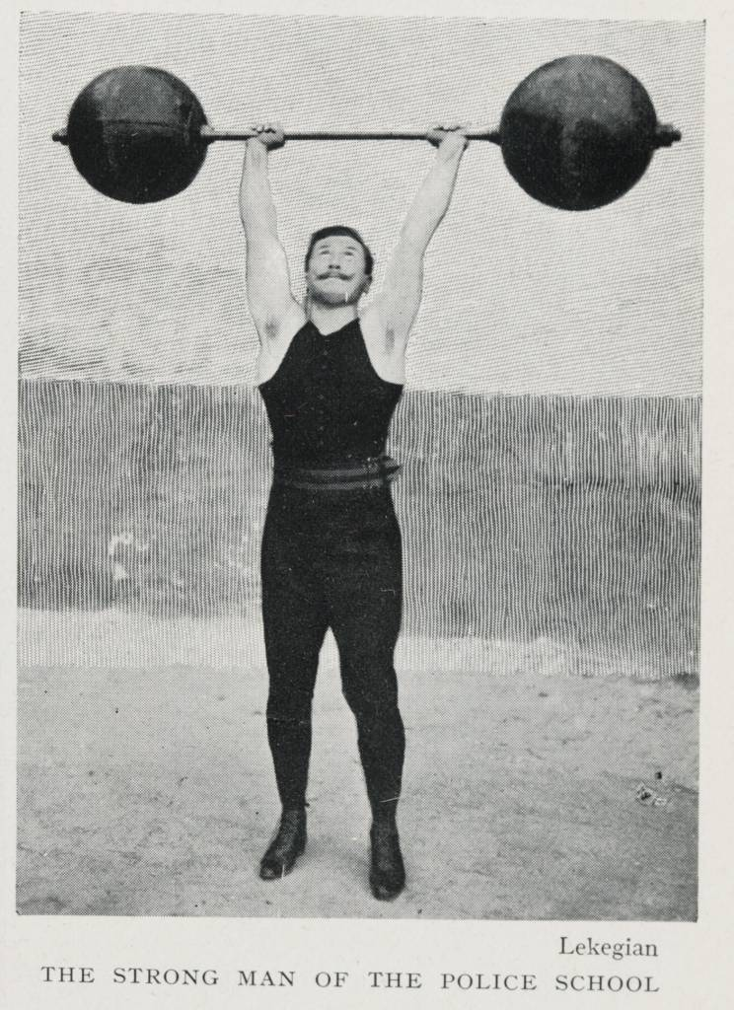
Strongly Typed
Must define type of variable
Allocates memory
Need to cast from type to type

Slide 16
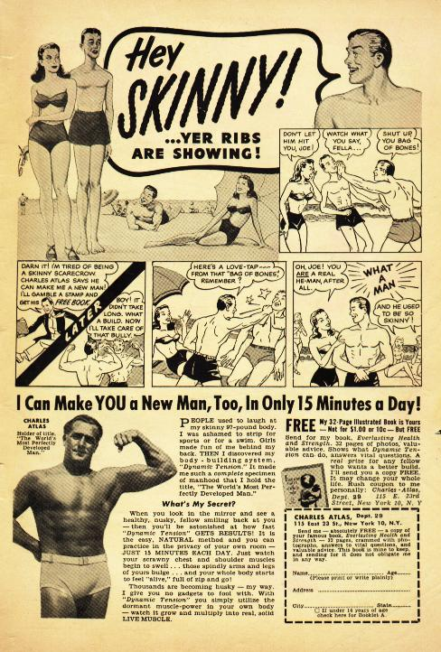
Weakly typed
Don’t need to declare first
Don’t need to cast (usually)
Duck typed

Slide 17
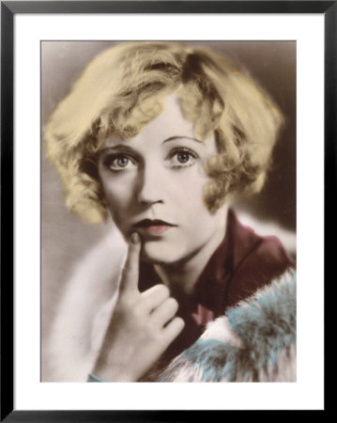
Which are these?
C
C#
Java
JavaScript
Ruby

Slide 18
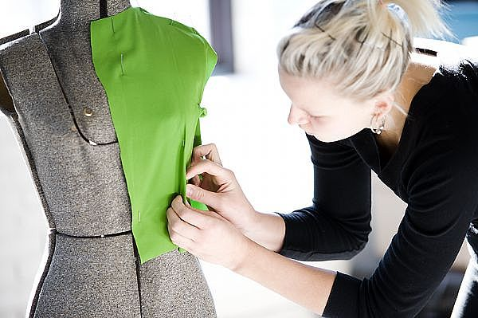
MVC Design Patterns
What is a design pattern?
What is the difference between an algorithm and a design pattern?
What design patterns are commonly used with Asp.Net MVC?
What is Model-View-Controller?
What is Model-View-View-Model?
What is a Data Repository?

Slide 19

Algorithm
Recipe
Step by Step plan
Computer Science is study of these

Slide 20
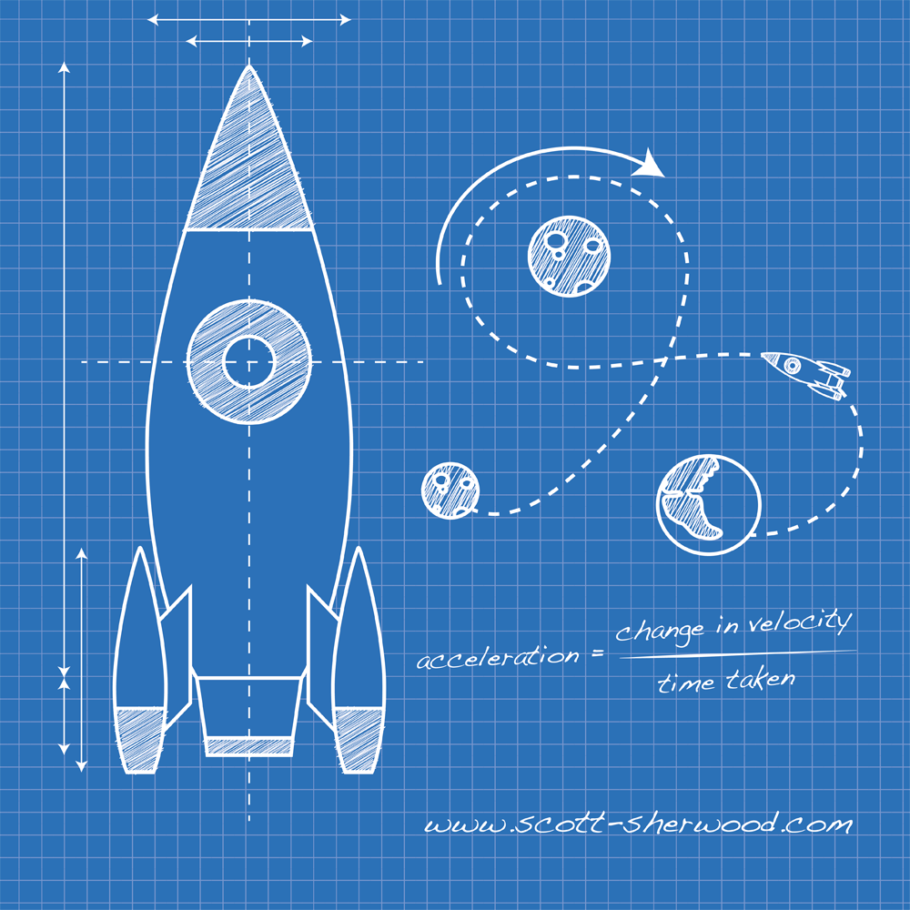
Design Pattern
Like a blue print
Structured association of objects and associations and actions to achieve a goal
Mostly for object oriented programming

Slide 21
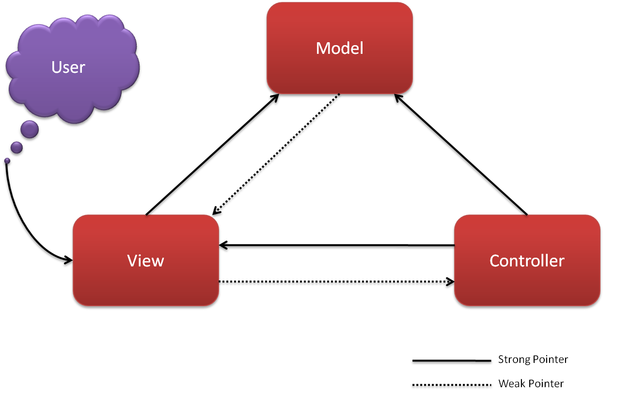
Model View Controller
Model
Schema
View
Human Interface
Controller
Logic and match maker

Slide 22
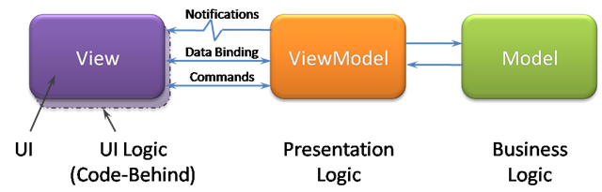
Model View ViewModel
WPF
AngularJS
Kendo UI
Data Binding
UI Elements are bound to View Model
Not event driven

Slide 23
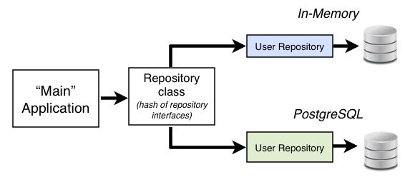
Database Repository
Entity Framework
Database
Tables
Query the tables

Slide 24
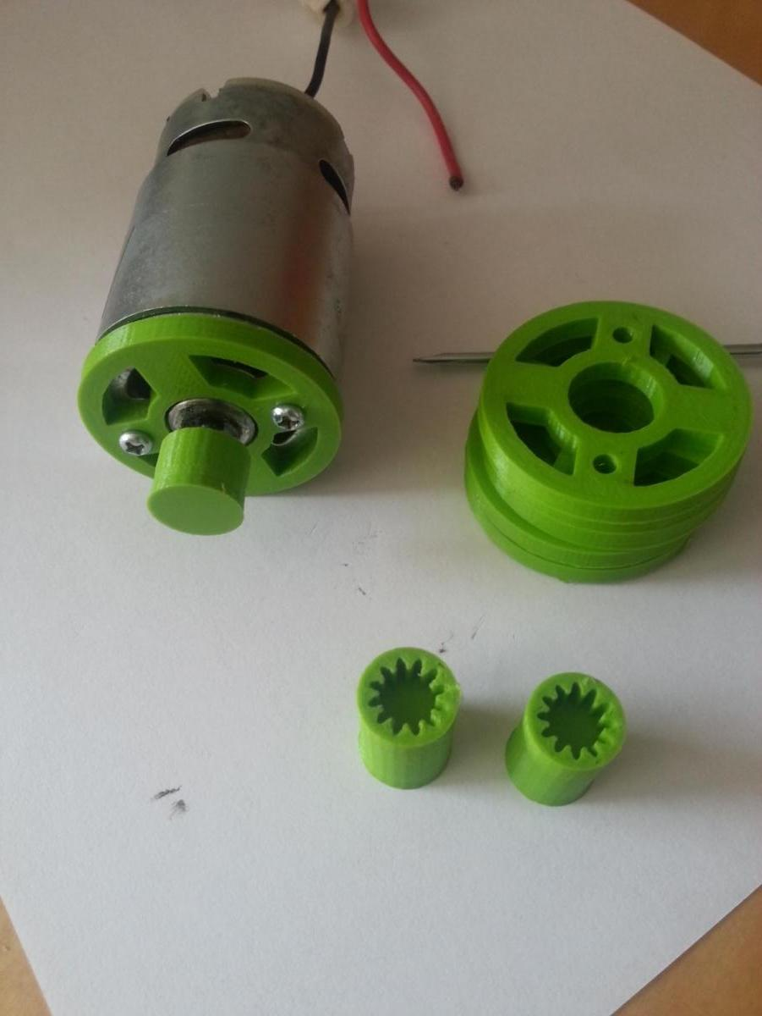
How do they fit together?
MVC is backend
If you need data can use EF
If you want binding you can use AngularJS or Kendo UI

Slide 25
MVC Design Patterns
What is a design pattern?
What is the difference between an algorithm and a design pattern?
What design patterns are commonly used with Asp.Net MVC?
What is Model-View-Controller?
What is Model-View-View-Model?
What is a Data Repository?

Slide 26
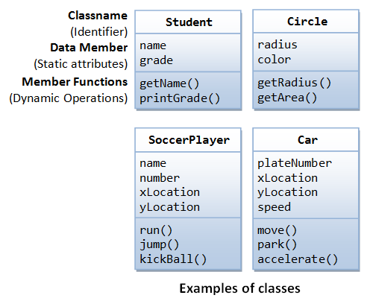
OOP for MVC Basics
What is an Interface in OOP?
How do you implement an interface?
What is an Abstract Class?
How do you implement an abstract class?
What do you need to create a controller in MVC?

Slide 27
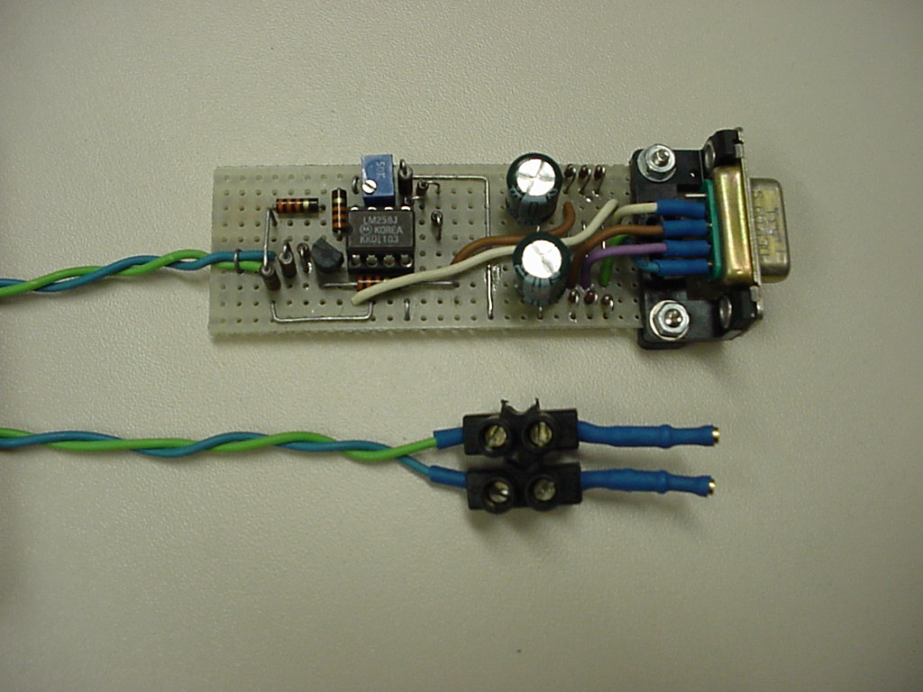
What is an interface?
Required pattern
You have to implement your own versions
Usually starts with the letter I

Slide 28
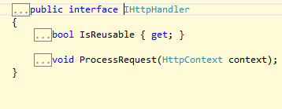
Examples of Interfaces
IDisposable
IComponent
IHttpHandler

Slide 29
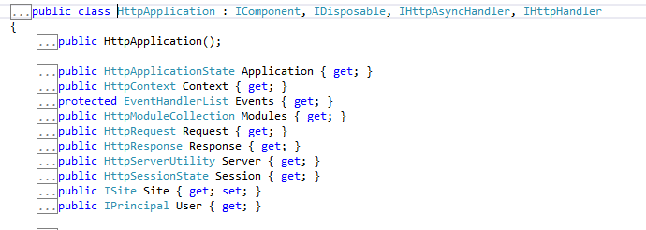

Examples of Implementing Interfaces

Slide 30

An abstract class
Has already implemented details
But you can’t create it with New

Slide 31

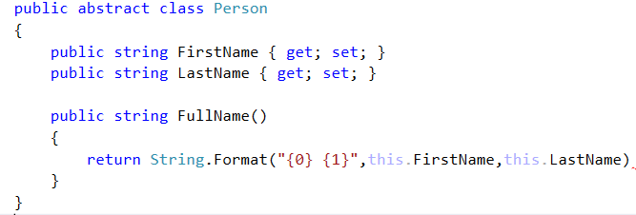
How do you implement an abstract class?

Slide 32
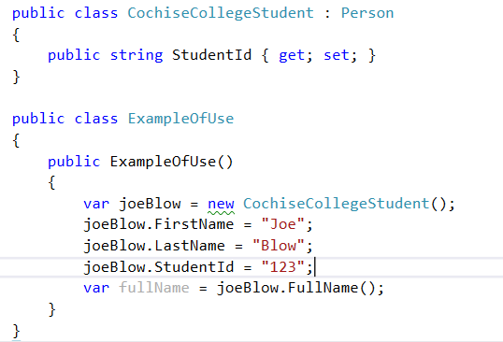
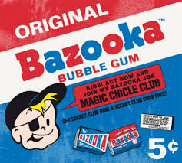
Implement it

Slide 33

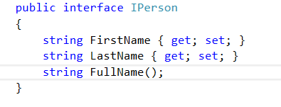
How to implement an interface

Slide 34

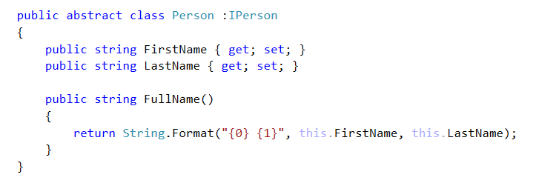
Do it!

Slide 35

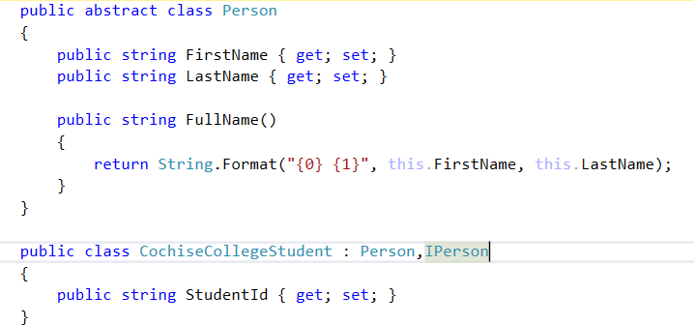
Or maybe

Slide 36
Learning by doing…
Create an interface for a classroom
Number of chairs
Teacher
CurrentStudents
Create an abstract class that implements Iclassroom
Add a CurrentAvailableSeats
Implement the classroom object

Slide 37
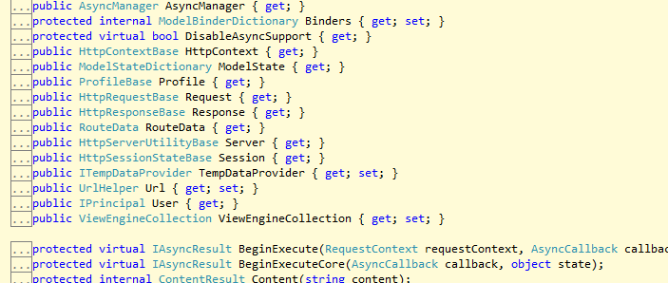
Controller abstract class

Slide 38
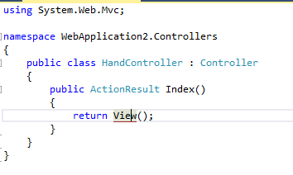
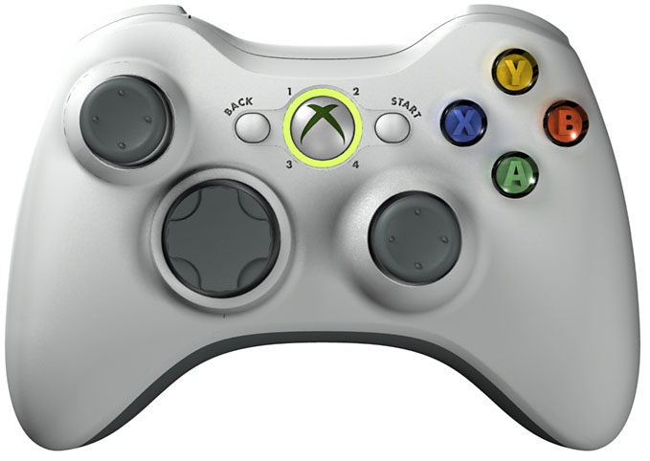
Let’s create a controller by hand

Slide 39
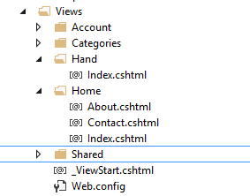

Let’s View It

Slide 40
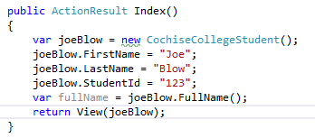
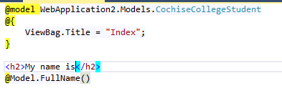
Passing objects

Slide 41

Learn by doing…
Pass your classroom object to a view

Slide 42
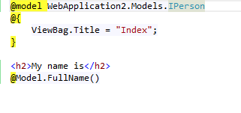
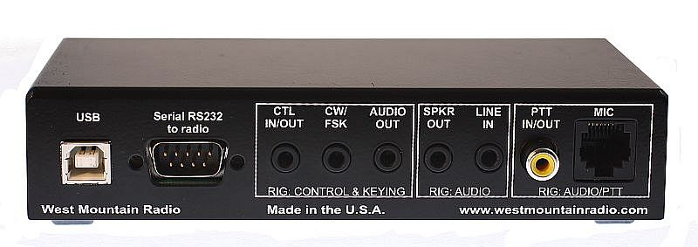
Advantages of Interfaces
Blueprint
Code against blueprint
Don’t need to be stuck to details

Slide 43

Advantages of Abstract Classes
Implement behavior in one place
Maps to abstraction
Mammals
Rectangle

Slide 44

Review of MVC OOP Basics
What is an Interface in OOP?
How do you implement an interface?
What is an Abstract Class?
How do you implement an abstract class?
What do you need to create a controller in MVC?

Slide 45
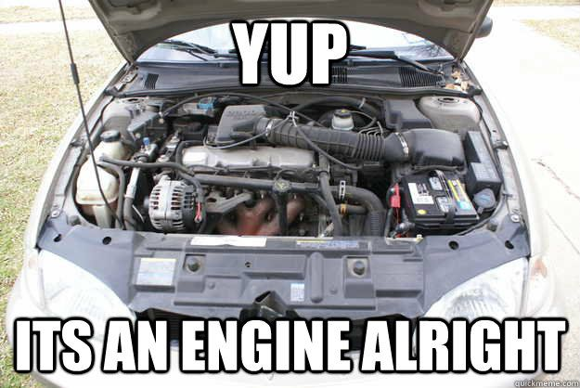
MVC under the hood
What file gets looked at first by MVC?
How does MVC figure out which page to show?
What is the route table?
What is routing?
How does routing happen in MVC?

Slide 46

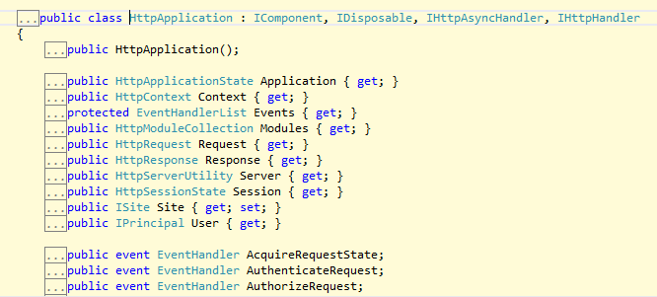
A good start
Global.asax.cs
Derives from System.Web.Application

Slide 47

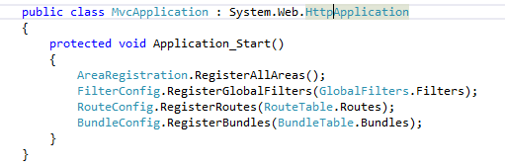
Global.asax.cs

Slide 48

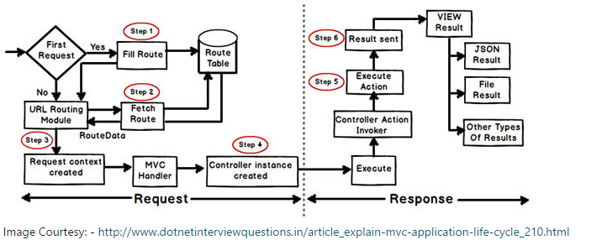
Routing

Slide 49
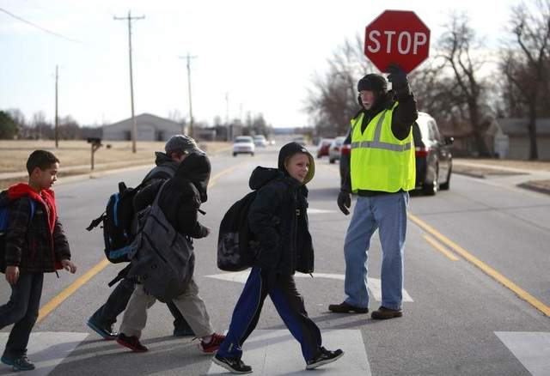
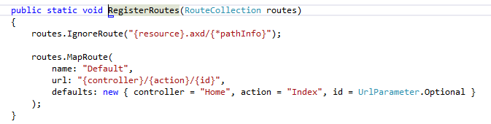
Default Routing

Slide 50

How many ways to home?
/
/Home
/Home/Index
Home/Index/purplealligator
home/index/purple/alligator

Slide 51

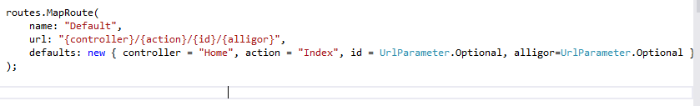
Can you make this work?
home/index/purple/alligator

Slide 52

Passing parameters
What is the parameter?
/home/index/2
/about/home
/you/are/doing_good

Slide 53

Exercise for learning
Create a new route
Create a route where it takes the action first and then the controller

Slide 54

Putting it together
Modify the previous exercise so that the teacher’s name is taken from the parameter

Slide 55
MVC under the hood
What file gets looked at first by MVC?
How does MVC figure out which page to show?
What is the route table?
What is routing?
How does routing happen in MVC?

Slide 56
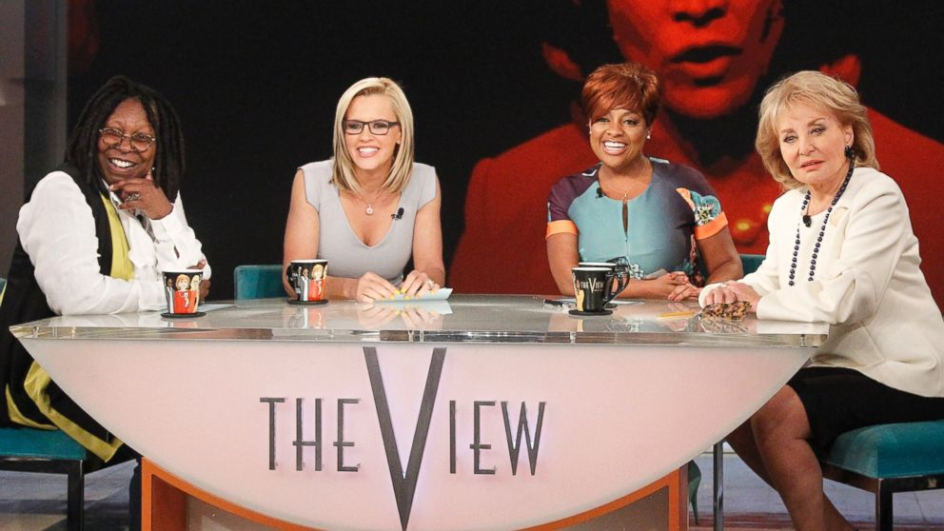
Priming on Views
Where are views located?
What is the default view for a controller action?
What is an HTML Helper?
Name three HTML Helpers.

Slide 57

HTML Helpers
HTML.Textbox
HTML.RadioButton
HTML.CheckBox
HTML.TextboxFor –oops not yet…

Slide 58
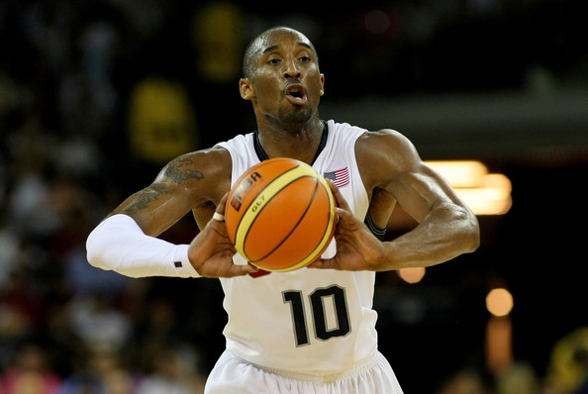
Passing parameters
Route
Request variables
GET
POST
Will form into objects

Slide 59
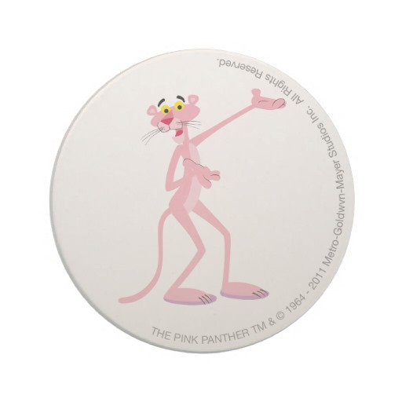
Let’s me show you some stuff
Parameters
Class via Get

Slide 60
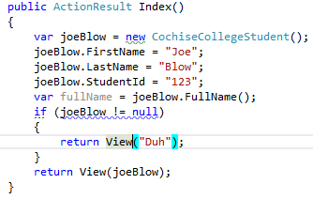
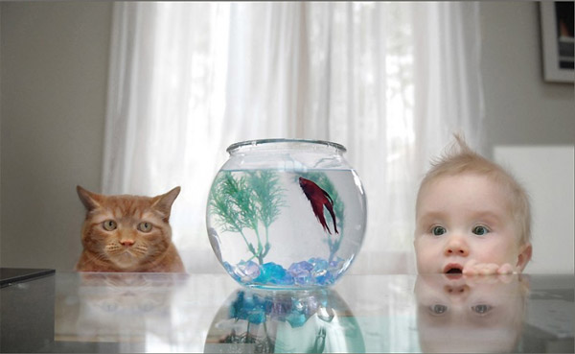
Different Views
You can change views

Slide 61
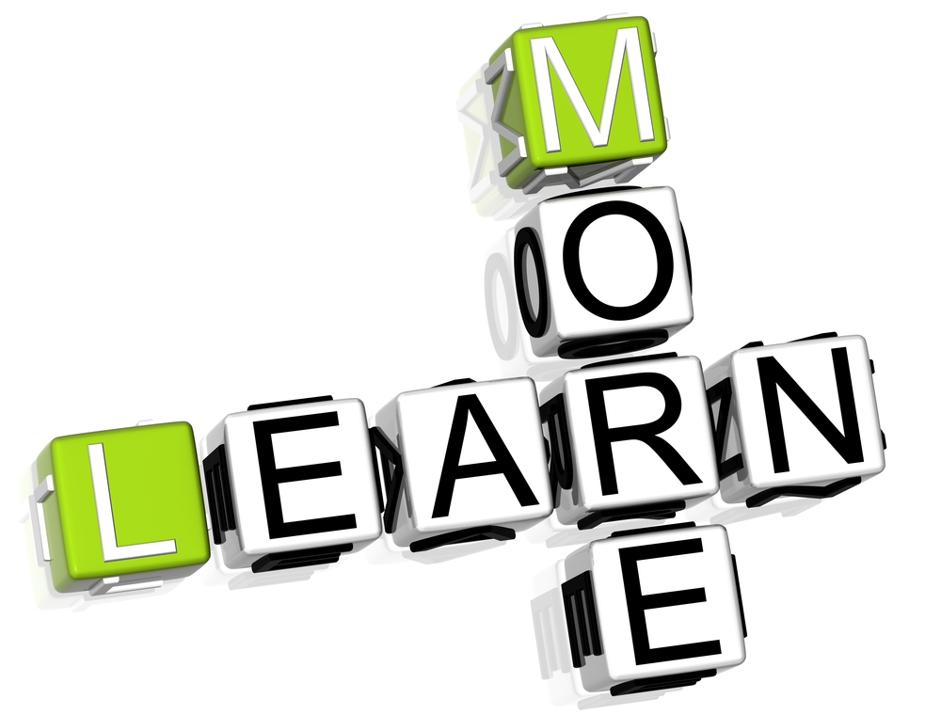
Exercises for learning
Create a function that receives a CochiseCollegeStudent object
Create a function that gets an int and pass a character. What happens?
Create a function that returns to another view

Slide 62
Priming on Views
Where are views located?
What is the default view for a controller action?
What is an HTML Helper?
Name three HTML Helpers.

Slide 63
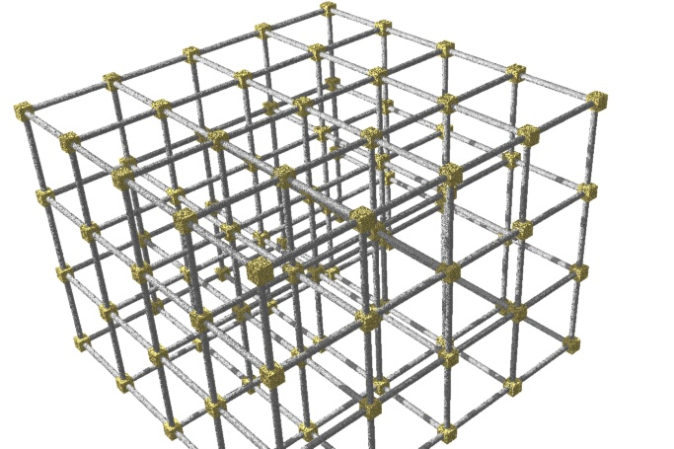
Entity Framework Priming
What is Entity Framework?
What are the two ways to use Entity Framework?
What design pattern does EF implement?
What abstract class must you implement for EF?
How do you create a table with EF Code First?
How do you view the table you created?
How do you create a foreign key in EF Code First?

Slide 64

What is Entity Framework?
Data Repository
Connect to Database
Tables are lists of classes

Slide 65
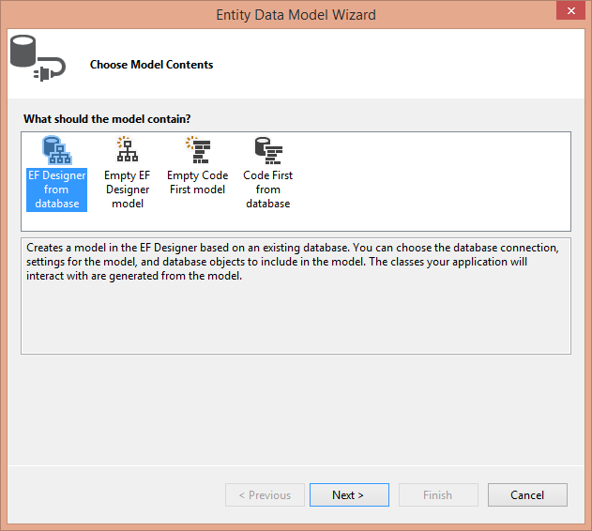
Two ways to use
Code First
Database First
Code First from Database
We are going to use Code First

Slide 66
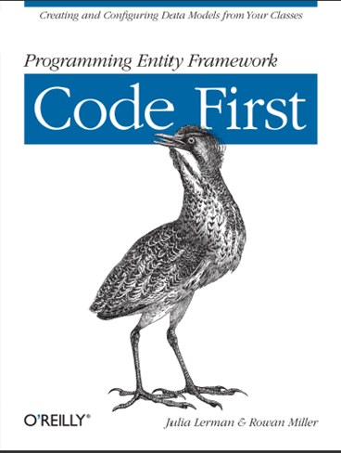
Code First
Implement DBRepository
Dbset<class>
Use-migrations
Allow automatic migrations
Magically creates database
Class turns into table in database

Slide 67

Some magic
ID becomes identity column
Virtual Icollection<Classname> Classnames
Becomes foreign key

Slide 68

The tables
Product
ProductId int
ProductName string
CategoryId int
Category
CategoryId int
CategoryName string

Slide 69


Let’s do it

Slide 70


Let’s do it

Slide 71


Let’s do it!

Slide 72

Migrations
Update-migrations
Need to allow automatic migrations

Slide 73


Let’s look at it

Slide 74


Let’s set it up
This is LINQ (We’ll talk about it next)

Slide 75

OK it is your turn to do it!
Product
ProductId int
ProductName string
CategoryId int
Category
CategoryId int
CategoryName string

Slide 76
Let’s do it

Slide 77
Let’s do it

Slide 78
Let’s do it!

Slide 79
Migrations
Update-migrations
Need to allow automatic migrations

Slide 80
Let’s look at it

Slide 81
Let’s set it up
This is LINQ (We’ll talk about it next)

Slide 82

The magic happens

Slide 83

SQL Happens

Slide 84
Entity Framework Priming
What is Entity Framework?
What are the two ways to use Entity Framework?
What design pattern does EF implement?
What abstract class must you implement for EF?
How do you create a table with EF Code First?
How do you view the table you created?
How do you create a foreign key in EF Code First?

Slide 85
LINQ Priming
What is LINQ?
Why does LINQ work with?
What are the two ways to use LINQ?
Describe the syntax of LINQ?
What is projection?
What items can be projected?
What are the limits of anonymous functions?
What are common LINQ functions?

Slide 86

What is LINQ?

Slide 87

What is LINQ?
Language
INtergrated
Query

Slide 88

Works on…
Everything
Strings
Lists
XML
Datasets

Slide 89

Life Before LINQ
Write out connection code, pick a data object, iterate
Why this stinks…
Redundant
Different objects have different methods
No good intelligence for data results without effort
Notes:
* If any of these issues caused a schedule delay or need to be discussed further, include details in next slide.

Slide 90

LINQ
Functional Language
Dyslexic SQL
Select columns from rows where column=value
from variable in tablename where tablename.column==“value" select variable.*
Examples in LINQPad
A simple query expression
LINQ works on objects
Notes:
Duplicate this slide as necessary if there is more than one issue.
This and related slides can be moved to the appendix or hidden if necessary.

Slide 91

http://www.albahari.com/nutshell/linqsyntax.aspx

Slide 92

LINQPAD Examples
Looking at the other LINQPad Examples
LINQ to SQL
Note can run SQL from LINQPAD
Joins are for wimps → use your relationships to find objects
SU Universe example
Notes:
Duplicate this slide as necessary if there is more than one issue.
This and related slides can be moved to the appendix or hidden if necessary.

Slide 93

101 Examples
http://msdn.microsoft.com/en-us/vcsharp/aa336746.aspx
02193369

Slide 94

var-E kewel keyword
I know all about you
Dynamic typing
Gives intellisense

Slide 95


Looks like a duck…
I am not a duck!
Compiles exactly the same as using same type
So why use it?
Create a new type on the fly

Slide 96


But wait there’s more…
Can rename columns
This creates a new class on the fly
This is called projection
Note you can move items for readability

Slide 97


If you order right now…
Can also create classes inline
These also have intellisense
The previous are anonymous classes
Supports hierarchical data shaping

Slide 98



Can’t touch this
Values are immutable
But you can bind with this!

Slide 99

What the s=> s.IsThis?
Lambda expression
Let’s step back for a second
In LINQ you can write queries in multiple different ways but two main types
Fluent Syntax
Query Expression

Slide 100


A tale of two queries
Fluent looks like dyslexic SQL
Expressions look like object methods
Some items like Distinct() can only be used in one form

Slide 101

Fluent
I’m flew-ent!
Start off with “from <variable> in <linqobject>
This allows intellisense!
Always end with select
Usually are not compiled
Must end with ToList or it’s kin to compile

Slide 102



To compile or not compile

Slide 103


Lay the lambda down with the lion
Let’s play the same game

Slide 104

Quick Review
Fluent syntax must have select
Expression syntax need not have select
Fluent syntax must have a variable (the lambda)
Expression doesn’t need the lambda but can use it
Which to use????

Slide 105

Some pros and cons
Expression syntax has items such as Distinct that you can use in fluent syntax
Fluent is easy to understand because it is SQL-ish
Expression syntax allows some pretty slick binding items
I prefer to mix em

Slide 106

LINQ and EF
Where
First
FirstOrDefault
Select
OrderBy
Count

Slide 107
Exercise for Learning
Download LINQPad
Run through the getting started exercises

Slide 108

LINQ Review
What is LINQ?
Why does LINQ work with?
What are the two ways to use LINQ?
Describe the syntax of LINQ?
What is projection?
What items can be projected?
What are the limits of anonymous functions?
What are common LINQ functions?

Slide 109
LINQ and EF
How do you add a new row?
How does this change if you have an ID?
How does it change if there is a foreign key?
How do you use the seed function?

Slide 110


Adding a product

Slide 111

Think about it
Why did I not include the id?
What happens if I run it again?
Why did I not create a product first?

Slide 112


Seed function

Slide 113

Learn by doing
Create a new product via a controller
Create a function inserts the name of the id as a new category
Create a LINQ statement to return the first row of the category table when sorted by categoryname

Slide 114
LINQ and EF
How do you add a new row?
How does this change if you have an ID?
How does it change if there is a foreign key?
How do you use the seed function?

Slide 115

LINQ and MVC
What is scaffolding?
What options can you use with scaffolding?
What is the difference between TextBox vs. TextBoxFor?
How are lists implemented in views?

Slide 116

Invoking the scaffolding

Slide 117


Slide 118

Looking through the files
Index
Details
Create
Edit

Slide 119

Learn by doing
Create scaffolding for products and categories
Look through all of the code

Slide 120
LINQ and MVC
What is scaffolding?
What options can you use with scaffolding?
What is the difference between TextBox vs. TextBoxFor?
How are lists implemented in views?

Slide 121

jQuery
What is the difference between a scripting language and a compiled language?
What is the difference between strongly typed vs
What is the function that you should implement all jQuery functions inside of?
What 3 types of selectors can be used with jQuery?
How do you get/set a form value?
How do you get/set html?
How do you call another page with jQuery?

Slide 122

JavaScript and jQuery
Javascript is the language
jQuery is the most important library on the web
Used for DOM manipulation

Slide 123

Document.ready

Slide 124

Selectors
Class
Id
Tag

Slide 125

Form values
val()
val(“my value”)

Slide 126

Containers
html()
html(“new html”)
text()
text(“text”)

Slide 127

Ajax
Asynronous Javascript and XML
Not so much XML any more

Slide 128

Learn by doing
Allow the user to enter a name
Return the value via ajax to another part of the page

Slide 129
jQuery
What is the difference between a scripting language and a compiled language?
What is the difference between strongly typed vs
What is the function that you should implement all jQuery functions inside of?
What 3 types of selectors can be used with jQuery?
How do you get/set a form value?
How do you get/set html?
How do you call another page with jQuery?

Slide 130
What we covered
MVC Design Patterns
Basic MVC Insides
Routing
LINQ
Entity Framework
JavaScript and jQuery

Slide 131

Test Prime
How do you create a unit test?
What attributes do you need to use?
What function can you use for most tests?

Slide 132


